Slide 1
How GM Magnus Carlsen’s Chess openings have changed over his career
CHESS OPENINGS ANALYSIS · 2001–2026
Classifying 17,456 games by the moves actually played, with Levenshtein distance and k-means clustering
Lucas Santucci, Levi Tipton, Owen Youngblood
Notes:
Our project looks at how Magnus Carlsen’s opening choices have changed over his career, from 2001 to today

Slide 2
How have Carlsen’s openings changed over his career?
1 · PROJECT OBJECTIVE
Why it’s interesting
Why it’s hard
Carlsen has been world No. 1 for over a decade. The opening is where preparation matters most, and he is known for steering away from heavy theory.
There are over 3,000 named openings, and one line can run 20 moves. Top players rarely follow a named line to its end.
Can the data show how his style changed?
So the opening label stored in each game is only a rough guess. The real task is to classify openings from the moves.
Notes:
How have Carlsen’s openings changed over his career? It’s interesting because the opening is where preparation matters most, and Carlsen has a reputation for avoiding heavy theory. The hard part is measuring it because there are over 3,000 named openings and top players rarely stick to one all the way

Slide 3
Three sources, 17,456 games
2 · DATA
7,818
9,638
3,865
Professional games
Online games
Named opening lines
PGN file, 2001–2026, from PGN Mentor. Players, date, ECO code and moves. Mixes classical, rapid and blitz.
Chess.com public API, one request per monthly archive, 2014–2026. Mostly blitz and bullet.
Lichess opening tables (open data). Each has a name, ECO code and moves, up to 36 half-moves long.
About 50 MB of raw data. The first 36 half-moves of each game are kept, since no named line is longer.
Notes:
We used three data sources. First, a PGN file of 7,818 of Carlsen’s professional games from 2001 to 2026. Second, 9,638 online games from Chess.com, downloaded with their public API. Third, the Lichess opening tables: 3,865 named lines with their moves. Altogether that’s 17,456 games and about 50 megabytes.

Slide 4

From raw games to trends in five steps
3 · APPROACH
01
02
03
04
05
Retrieve
Clean
Match
Cluster
Chart
Chess.com API, plus the PGN file
Replay moves with python-chess; drop 325 variant games
Levenshtein distance and transpositions against 3,865 named lines
k-means on board positions, 20 groups
Trends per year, by source and by color
Steps 3 and 4 took most of the work. They are the next two slides.
Notes:
First we download the games, then replay every move on a virtual board with the python-chess library. Step 3 matches each game to a named opening, and step 4 groups the games into clusters. Finally we charted the results by year

Slide 5
Matching each game to its closest named line
3 · APPROACH · MATCHING
Exact
Game 1.e4 c5 2.Nf3 Nc6 3.d4 cxd4 4.Nxd4 e5 5.Nb5 d6
Every move matches
Line Sicilian Defense: Kalashnikov Variation
Close variation
Game 1.e4 e6 2.d4 d5 3.Nc3 Bb4 4.e5 Ne7 5.a3 Bxc3+ 6.bxc3
1 edit in 11 half-moves
Line 1.e4 e6 2.d4 d5 3.Nc3 Bb4 4.e5 c5 5.a3 Bxc3+ 6.bxc3
Transposition
Game 1.d4 g6 2.e4 d6 3.Nc3 Bg7
4 edits apart, same position
Line 1.e4 g6 2.d4 Bg7 3.Nc3 d6 (Modern Defense)
Levenshtein distance counts the moves to add, remove or change. Each line scores its length minus 2 × edits, and the best score names the game.
Notes:
For each game, we compare its opening moves with all 3,865 named lines. Levenshtein distance counts how many moves you’d have to add, remove or change to turn one into the other. The top row is an exact match. The middle row differs by one move out of eleven, so it still counts as that French line, just a close variation. The bottom row is the problem we ran into, these two move orders are four edits apart, but they reach exactly the same position in the end. So we added a second check, if a game ever reaches the position a named line ends in, it counts as that line

Slide 6
Letting k-means build its own categories
3 · APPROACH · CLUSTERING
01
02
03
04
Snapshot
Encode
Compress
Group
The board after every 2 half-moves, up to 16: eight boards per game
768 yes/no values per board: is this piece on this square?
Truncated SVD turns 6,144 values into 50 numbers per game
k-means sorts the games into 20 clusters, each named after its most common opening
Clustering uses positions, not move order, so transposed games land in the same cluster.
Notes:
The second approach sorts games into groups without using opening names at all. For each game, we look at what the board looks like during the first eight moves. Then a k-means algorithm groups together games whose boards look alike, giving 20 groups. Only after that do we give each group a name, based on the opening that appears most often inside it. The groups mostly line up with the familiar opening names, but some of them bring together openings with different names that lead to similar positions.

Slide 7
Two problems that shaped the project
4 · CHALLENGES
PROBLEM 1
PROBLEM 2
Opening labels were vague and unreliable
Two sources in two different formats
Each game’s header stores a single ECO code. It often doesn’t match the moves played, and it can’t show how closely a game follows its opening.
The professional games are plain PGN text. Chess.com sends JSON with clock times inside the moves, plus Chess960 and other variant games.
SOLUTION
SOLUTION
Classify openings from the moves instead, with Levenshtein distance and k-means clustering.
Replay every move with python-chess so both sources use the same notation, and drop the 325 variant games.
Notes:
We ran into two main problems. First, the opening label in each game’s header turned out to be unreliable and not specific enough so we had to use Levenshtein distance and k means clustering to better classify openings. Second, the two sources were formatted differently: the PGN is plain text, while Chess.com sends JSON with clock times in the moves and some Chess960 games.

Slide 8
Only 58% of games follow a named line exactly
5 · RESULTS
58%
27%
15%
Exact move order
Transposition
Close variation
10,111 games follow a named line move for move
4,691 games reach a named line by another move order
2,654 games are 1 to 5 moves away from a named line
The move-based label agrees with the header ECO code for 74% of games.
Notes:
Results: Only 58% of games follow a named line’s exact move order. Another 27% get there by a different move order (a transposition), and 15% are close variations.

Slide 9
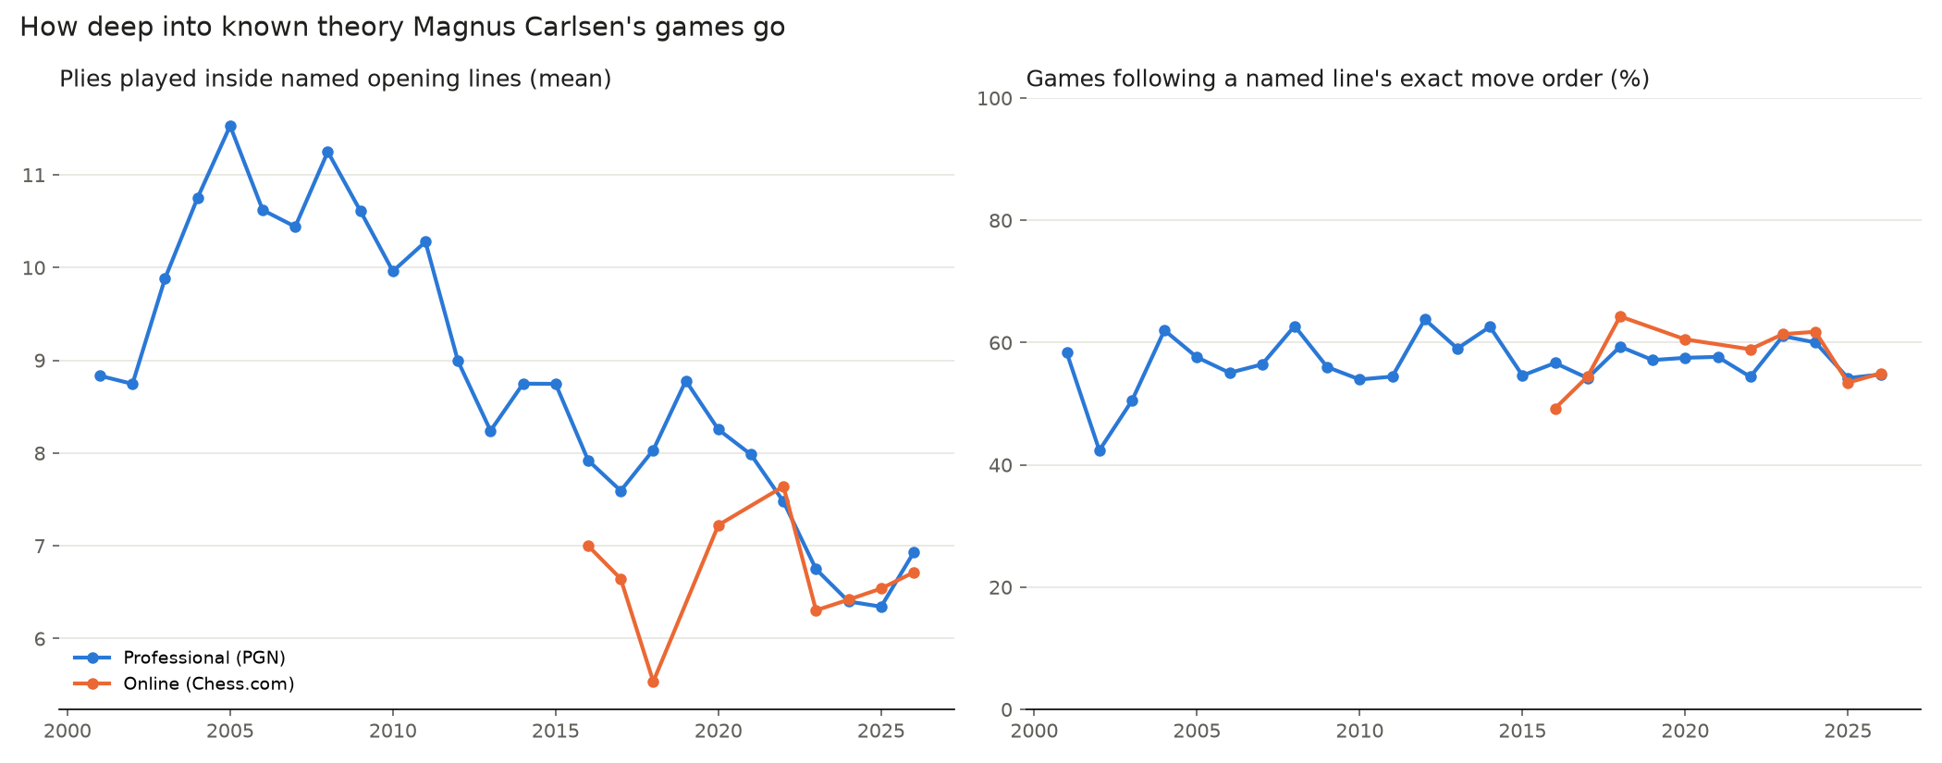
He now leaves known theory much earlier
5 · RESULTS
Professional games: about 11 half-moves in named lines in 2005–08, about 6.5 in 2023–25.
Notes:
Book depth is the number of moves a game stays inside named opening lines. In Magnus Carlsen's professional games, it fell from about 11 moves in 2005 to about 6.5 in 2023. So he leaves known theory much earlier than he used to. He still starts in normal openings, he just leaves them sooner.

Slide 10
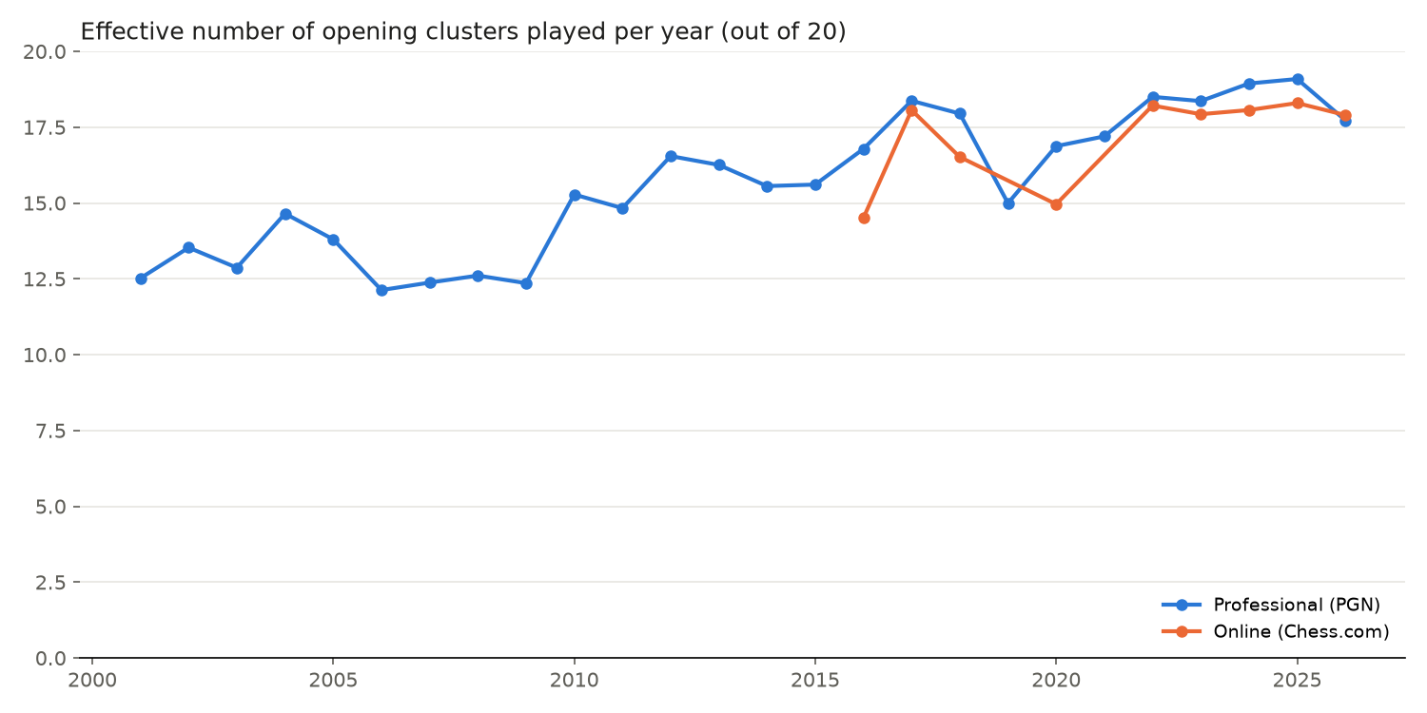
His repertoire has widened
5 · RESULTS
12–13 → 18–19
Effective number of clusters he plays per year, 2006–09 vs 2022–25, out of 20
His games now spread across almost every opening type, in both professional and online play.
Notes:
It rose from about 12 or 13 in the late 2000s to about 18 or 19 in recent years. His online games show the same level, so this isn’t only one data source.

Slide 11
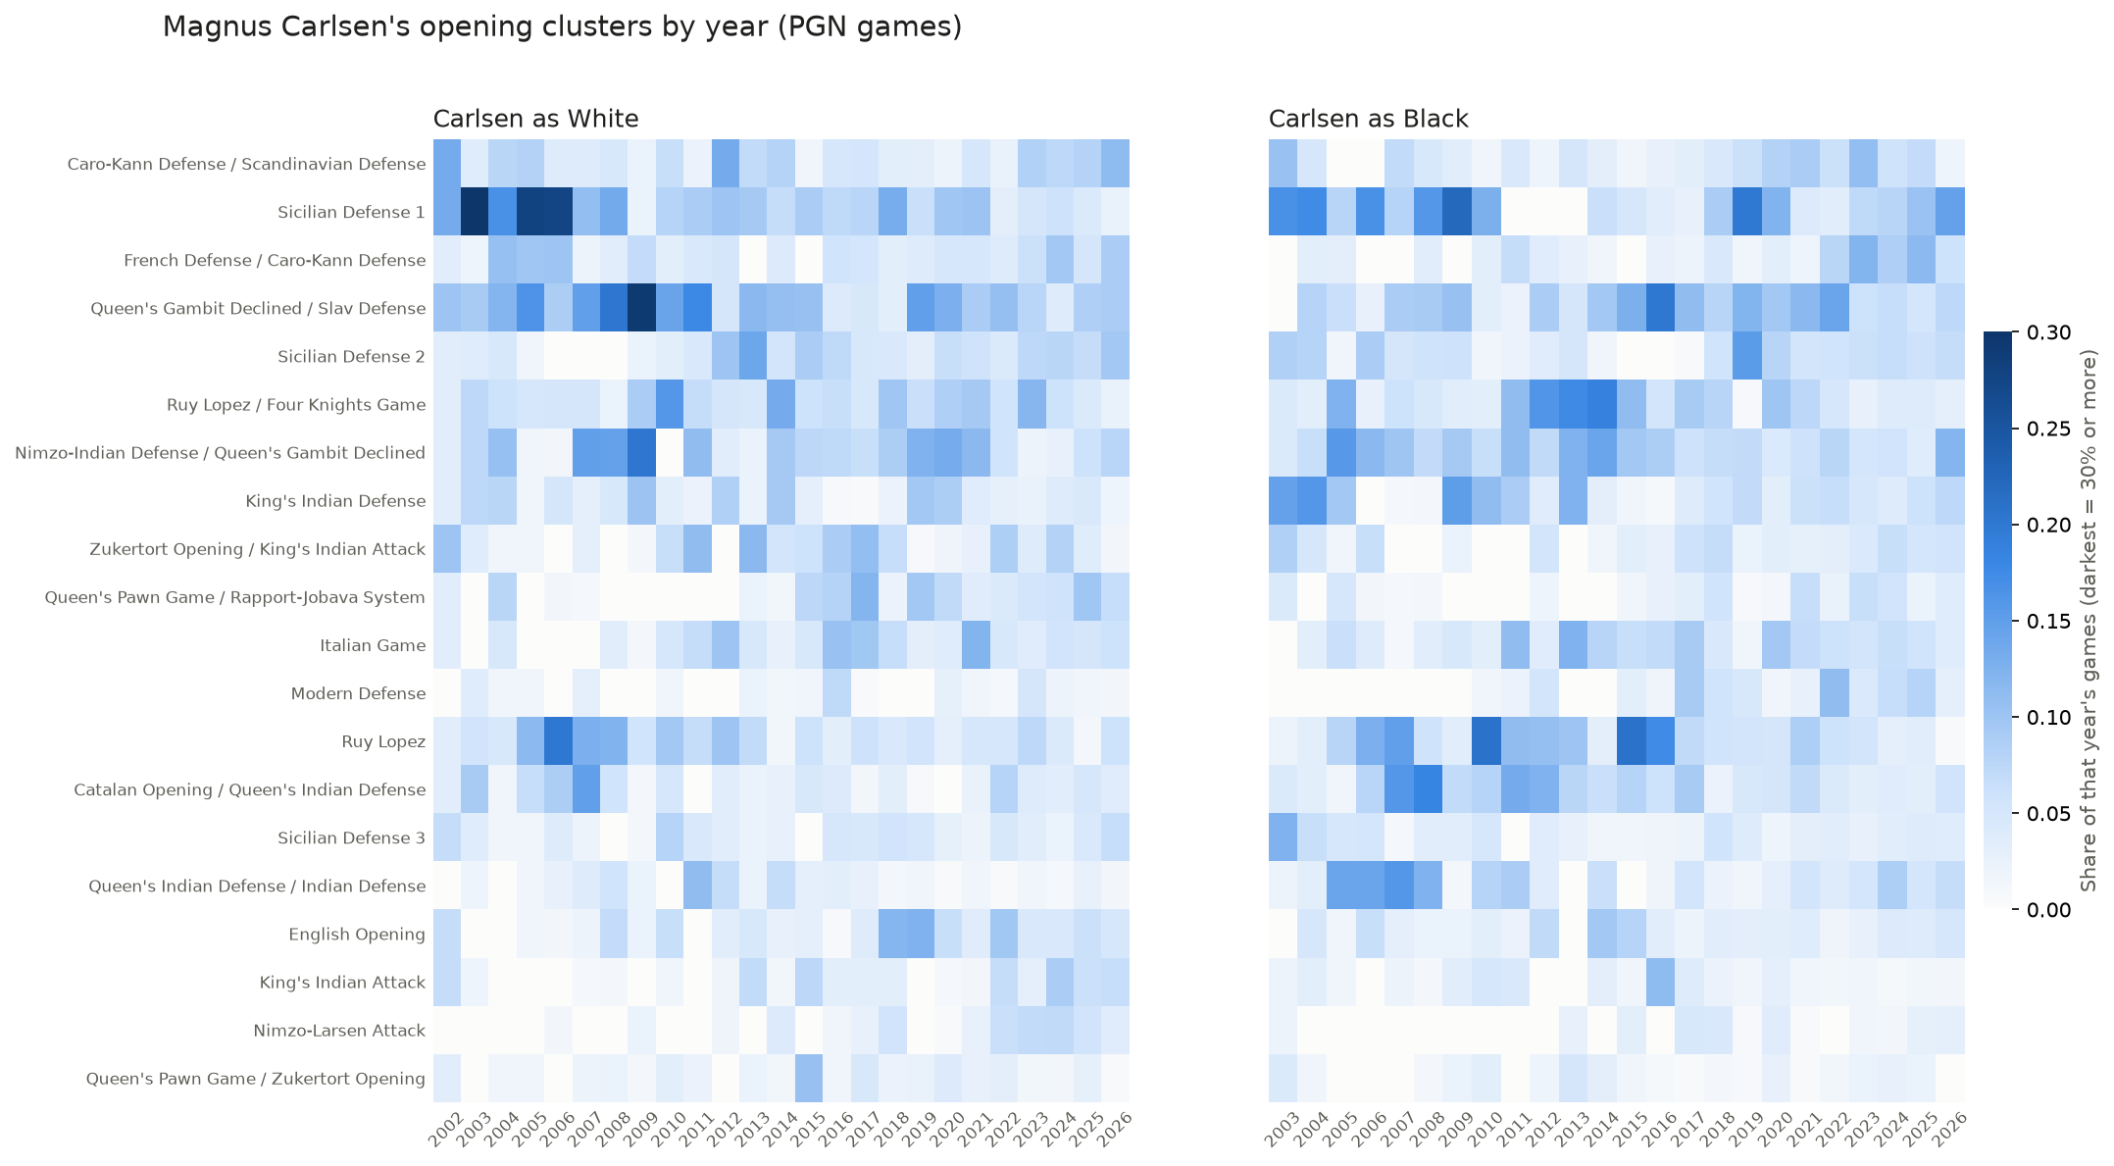
No single opening dominates any more
5 · RESULTS
16%
As White in 2001–10, the open Sicilian and Queen’s Gambit/Slav clusters each took 16% of his games
≤ 9%
The largest cluster’s share since 2019, as White or as Black
Notes:
This heatmap shows each cluster’s share of his professional games per year: White on the left, Black on the right. Darker means a bigger share. Early on there are a few dark cells: as White, the open Sicilian and Queen’s Gambit or Slav structures each made up 16 percent of his games. Since 2019 the columns are evenly pale: no cluster takes more than 9 percent, so his openings have become more varied.

Slide 12
From focused and theory-heavy to broad and unpredictable
6 · CONCLUSIONS AND LIMITATIONS
Achieved
Limitations
Next steps
All 17,456 games classified from their moves, not their header labels.
The PGN mixes time controls, and its game count jumps after 2020.
Repeat with classical games only.
Compare chessLM embeddings with board-position features, and test other cluster counts.
Book depth only counts named lines. 20 clusters is a choice: silhouette scores are flat.
Objective met: clear trends in theory depth and variety.
Notes:
To sum up: we classified every game from its moves and the data shows Magnus Carlsen moving from a focused, theory-heavy repertoire to a broad one that leaves theory early. Magnus himself has said that he exits theory early to throw off his younger opponents who do a lot of memorization, so our findings make sense.
For limitations, The professional file mixes classical, rapid and blitz, and has many more games after 2020, so faster games could explain part of the drop in book depth. Book depth only counts the named lines, and 20 clusters was our choice, since the data has no natural number. Next, we might rerun everything on classical games only and potentially expand to other grandmasters to see if this is a chess wide phenomenon or not.

